Slide 1

Building Systems of Care:
A Primer on Designing and Implementing Effective Systems of Care
Elizabeth Manley
The TA Network for Children’s Behavioral Health
The Institute for Innovation and Implementation
Hennepin County Technical Assistance Visit

Slide 2
This training is hosted by the National TA Network for Children’s Behavioral Health, operated by and coordinated through the University of Maryland.
This presentation was prepared by the National Technical Assistance Network for Children’s Behavioral Health under contract with the U.S. Department of Health and Human Services, Substance Abuse and Mental Health Services Administration, Contract #HHSS280201500007C. The views, opinions, and content expressed in this presentation do not necessarily reflect the views, opinions, or policies of the Center for Mental Health Services (CMHS), the Substance Abuse and Mental Health Services Administration (SAMHSA), or the U.S. Department of Health and Human Services (HHS).

Slide 3

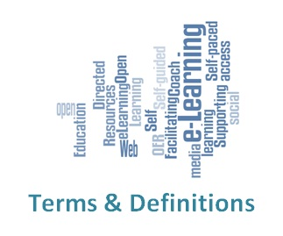

Definition, History, Values, Populations

Slide 4
Definition of a System of Care
A system of care incorporates a broad, flexible array of effective services and supports for a defined population that is organized into a coordinated network, integrates care planning and management across multiple levels, is culturally and linguistically competent, builds meaningful partnerships with families and youth at service delivery, management, and policy levels, has supportive policy and management infrastructure, and is data-driven.
Pires, S. (2010). Building systems of care: A primer, 2nd Edition. Washington, D.C.: Human Service Collaborative for Georgetown University National Technical Assistance Center for Children’s Mental Health.

Slide 5
2013 SAMHSA Behavioral Health Disparity Impact Statements - required of SOC Expansion and other grantees
2013 FREDLA – family-run organizations
2011 SAMHSA SOC Expansion grants
2010 CMS CHIPRA Quality grants – fidelity
Wraparound through Care Management Entities
2010 Health Reform - system of care principles in health care
2003 Children’s Bureau - child welfare system of care grants
2003 YouthMove – youth movement
2002 President Bush’s New Freedom MH Commission - children’s recommendations
1997 Robert Wood Johnson Foundation Mental Health Services Program for Youth – introduction of managed care approaches to SOC
1993 President Clinton’s Health Care Reform Task Force - children’s plan
1992 Annie E Casey Foundation Urban Mental Health Initiative
1992 SAMHSA CMHI - services and supports
1989 Federation of Families –family movement
1984 CASSP – interagency coordination
1982 Unclaimed Children
Milestones in Evolution of Systems of Care
Pires, S. (2018) Washington, D.C.: Human Service Collaborative for University of Maryland Baltimore, Pre-Institute Building Systems of Care

Slide 6
Historic/Current Systems Problems
Lack of home and community-based services and supports
Cost
Rigid financing structures
Administrative inefficiencies; fragmentation
Knowledge, skills and attitudes of key stakeholders
Patterns of utilization; racial/ethnic disproportionality and disparities
Poor outcomes
Deficit-based/medical models, limited types of interventions
Pires, S. (2010). Building systems of care: A primer, 2nd Edition. Washington, D.C.: Human Service Collaborative for Georgetown University National Technical Assistance Center for Children’s Mental Health.

Slide 7
Effective System-Building Process
Effective System-Building Process
Leadership & Constituency Building
A Strategic Focus
Orientation to Sustainability
Pires, S. (2010). Building systems of care: A primer, 2nd Edition. Washington, D.C.: Human Service Collaborative for Georgetown University National Technical Assistance Center for Children’s Mental Health.

Slide 8
Characteristics of Systems of Care as Systems Reform Initiatives
From
To
Fragmented service delivery
Categorical programs/funding
Limited services
Reactive, crisis-oriented
Focus on “deep end,” restrictive
Children/youth out-of-home
Centralized authority
Foster “dependency”
Coordinated service delivery
Blended resources
Comprehensive service array
Focus on prevention/early intervention
Least restrictive settings
Children/youth within families
Community-based ownership
Build on strengths and resiliency
Pires, S. (2010). Building systems of care: A primer, 2nd Edition. Washington, D.C.: Human Service Collaborative for Georgetown University National Technical Assistance Center for Children’s Mental Health.

Slide 9
Frontline Practice Shifts
From
To
Control by professionals (I am in charge
Only professional services
Multiple case managers
Multiple service plans (meeting needs of agencies)
Family/youth blaming
Deficits focused
Mono Cultural
Partnerships with families/youth (acknowledging a power imbalance)
Partnership between natural and professional supports/services
One care coordinator
Single, individualized child and family plan (meeting needs of family and youth)
Family/youth partnerships
Strengths focused
Cultural/linguistic competence
Orrego, M. E. & Lazear, K. J. (1998) EQUIPO: Working as Partners to Strengthen Our Community and Conlan, L. Federation of Families for Children’s Mental Health

Slide 10
System Change/Transformation Focus
System Transformation
Policy
Level
Frontline Practice Level
Community Level
Management Level
(e.g., financing; regulations; rates)
(e.g., assessment; service planning; care management; services/supports provision)
(e.g., data; quality improvement; human resource development; system organization)
(e.g., partnerships with families and youth; natural helpers; community buy-in)
Pires, S. (2010). Building systems of care: A primer, 2nd Edition. Washington, D.C.: Human Service Collaborative for Georgetown University National Technical Assistance Center for Children’s Mental Health.

Slide 11
System of care is, first and foremost,
a set of values and principles that provides an organizing framework for systems reform on behalf of children, youth and families.
Family-driven and youth-guided
Home and community based
Strengths-based and individualized
Coordinated across providers and systems
Trauma-informed
Commitment to health equity through cultural and linguistic competency
Connected to natural helping networks
Resiliency-and recovery-oriented
Data-driven, quality and outcomes oriented
Pires, S. (2010). Building systems of care: A primer, 2nd Edition. Washington, D.C.: Human Service Collaborative for Georgetown University National Technical Assistance Center for Children’s Mental Health.

Slide 12

Definition of Family Driven
Family-driven means families have a primary decision-making role in the care of their own children as well as the policies and procedures governing care for all children in their community, state, tribe, territory and nation. This includes:
choosing culturally and linguistically competent supports, services, and providers
setting goals
designing, implementing, and evaluating programs
monitoring outcomes
partnering in funding decisions
Osher, T., Osher, D. and Blau, G. FFCMH and CMHS, SAMHSA.

Slide 13

Definition of Youth Guided
“Youth Guided means to value youth as experts, respect their voice, and to treat them as equal partners in creating system change at the individual, state, and national level.”
www.youthmovenational.org

Slide 14
Family Members and Youth:
Shifts in Roles and Expectations
*Recipients of information
*Unheard voice in program evaluation
*Recipients of services
*Uninvited key stake holders in training initiatives
*Anger adversity & resistance
*Passive partners in service planning
*Participate in program evaluation
*Partners in planning and developing services
*Participants in training initiatives
*Self- advocacy
*Service planning team leader
*Partner (or independent) in developing and conducting program evaluation
*Service providers
*Partners and independent consultants
*Advocacy & peer support
Lazear, K. & Conlan, L. (2004). “Primer Hands On” for Family Organizations. Human Service Collaborative: Washington, D.C.

Slide 15
Family & Youth Roles in Systems of Care
Roles | Descriptions
Peer Support Services | Information and referral Parent/Peer education Family & youth mentors Supervisor/management
Service Delivery | Peer navigators Care coordinators Family & youth support partners Project directors
Outreach & Public Awareness | Presentations Testimony Community Resource Fairs
Quality Assurance | Evaluation interviewers Board representation
Training & Technical Assistance | Curriculum development Workshops Co-trainers Consultants Certification
Conlan, L. (2013) Primer Hands On , Human Service Collaborative: Washington, D.C.

Slide 16
National Culturally and Linguistically Appropriate Services (CLAS) Standards
Governance, Leadership and Workforce Development
Communication and Language Assistance
Continuous Quality Improvement and Accountability
Advance Health Equity
Improve Quality
Eliminate Health Disparities
Culturally and Linguistically Competent Policies and Practices to Achieve Health Equity
www.thinkculturalhealth.hhs.gov/pdfs/NationalCLASStandards
Lazear, K. (2016) University of South Florida, Tampa, FL and Webster-Bass, S. Voices Institute, Jacksonville, FL

Slide 17
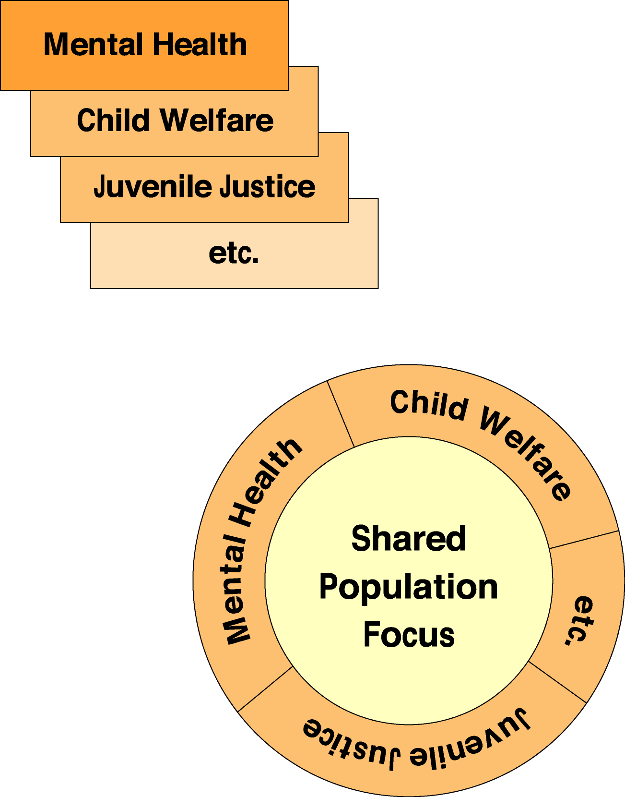
Categorical vs. Non-Categorical
System Reforms
Categorical
System
Reforms
Non-Categorical
Reforms
Pires, S. (2010). Building systems of care: A primer, 2nd Edition. Washington, D.C.: Human Service Collaborative for Georgetown University National Technical Assistance Center for Children’s Mental Health.

Slide 18
Total Population of Children and Families Who Depend on Public Systems
Children/youth/families
eligible for Medicaid.
Families who are not poor or
uninsured but who exhaust
their private insurance, often because
they have a child with a serious
emotional/behavioral challenge.
Families who are not poor
or uninsured and who may not yet
have exhausted their private insurance
but who need a particular type
of service not available through
their private insurer and only
available from the
public sector.
Children/youth/families
eligible for the State Children's
Health Insurance Program (SCHIP)
Children/youth/families
eligible for Tribal Authority
funding.
Children/youth/families who are
poor or uninsured
who do not qualify for
Medicaid or SCHIP.
Pires, S. (2010). Building systems of care: A primer, 2nd Edition. Washington, D.C.: Human Service Collaborative for Georgetown University National Technical Assistance Center for Children’s Mental Health.

Slide 19


Slide 20
Children and Youth with Serious Behavioral Health Conditions Are A Distinct Population from Adults with Serious and Persistent Mental Illness
Have different mental health diagnoses (ADHD, Conduct Disorders, Anxiety; not so much Schizophrenia, Psychosis, Bipolar as in adults), and diagnoses change often.
Do not have the same high rates of co-morbid physical health conditions.
Coordination with other children’s systems (CW, JJ, schools) and among behavioral health providers, as well as family issues, consumes most of care coordinator’s time, not coordination with primary care.
Are multi-system involved – two-thirds typically are involved with CW and/or JJ systems and 60% may be in special education – systems governed by legal mandates.
To improve cost and quality of care, focus must be on child and family/caregiver(s) – takes time – implies lower care coordination ratios and higher rates.
Pires, S. March 2013 Customizing Health Homes for Children with Serious Behavioral Health Challenges. Human Service Collaborative. Washington, D.C.

Slide 21
Prevalence/Utilization Triangle
More
complex
needs
Intensive
Services – 60% of
$$$
Home and community services and supports; early intervention–35% of $$
2 - 5%
Prevention and Universal Health Promotion – 5% of $
15%
Less
complex
needs
80%
Pires, S. (2010). Building systems of care: A primer, 2nd Edition. Washington, D.C.: Human Service Collaborative for Georgetown University National Technical Assistance Center for Children’s Mental Health.

Slide 22
The New Jersey Children’s System of Care - CSOC

Slide 23
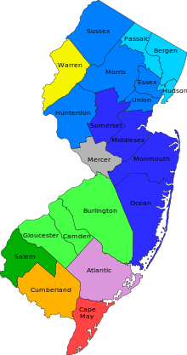






Rutgers UBHC Training and Technical Assistance --Trains All System Partners, Families
Department of Children and Families
Division of Children's System of Care (CSOC)
Trauma Informed SOC, Utilizes an Integrated Approach to Care Embedded in System of Care Approach (values and principles)
Policy Authority, Funding Agency
Approves and manages the Provider Network
(BH carve out; Providers bill on fee for service basis)
Dept. of Human Services
Division of Mental Health and Addiction Services
Youth and Family Voice
Dept. of Human Services
Division of Medical Assistance and Health Services (Medicaid)
Dept. of Human Services
Division of Developmental Disabilities
The New Jersey Children’s System of Care
Statewide Youth Ambassador
Children’s Interagency Coordinating Council (CIACC)-One per county (21)-local planning bodies
Contracted System Administrator
(ASO+)
Single Point of Entry and Access to Care 24/7
Triage, Utilization Management
Care Coordination
Authorizes Services
Non risk based
Hosts CSOC’s MIS (EHR and Data)
Populations Served are youth (and their families) with one or more of the following:
Behavioral health challenges
Substance use challenges
Intellectual/developmental disabilities
Autism
**Youth with multisystem involvement:
child welfare and/or juvenile justice
Family Support Organizations
Family-led peer support and advocacy for parents/caregivers and youth group
Other Authorized Services includes but is not limited to:
Biopsychosocial Assessments
In home Clinical/Therapeutic
Out of Home Care (OOH)
Partial Hospitalization/Partial Care
Substance Use Services
In home Behavioral for I/DD youth
Family Support Services for I/DD Youth
Non Medical Transportation
Interpreter Services
Outpatient
Assistive Technology
Mobile Response & Stabilization Services
Crisis response and planning; 24/7/365 within 1 hour
Care Management Organization
Utilizes wraparound model to serve youth and families with moderate and complex needs; designated health home entity
Physical Health Integration
Child Family Teams
CANS
ASSESSMENT TOOL Utilized in Triage, for Treatment Planning and Outcomes Tracking
  1115 Waiver-Children’s Supports Waiver, I/DD and SED
  State Plan Amendments
    Targeted Case Management-CMO
    Psych under 21 Benefit-OOH Programs
    Rehabilitative Option-MRSS, IIC/BA, Out of Home
  State Option to Provide Health Homes
  Flex Funds
Client
Case
Placement
State and Federal Appropriations
Title XIX and Title XXI

Slide 24
Language Is Important
Client
Case
Placement

Slide 25
Financing Title XIX Funding -Rehab Option -Targeted Case Management Child Welfare Juvenile Justice 1915 like (i) or (c) 1115 Waiver CHIP/SCHIP State Funds | Environment Political Perspectives of Leaders Lawsuits/Settlements Crisis/Tragedy Mandates Community Will Economy
Priorities Increase Access to Care Addressing Urgency Evidence Informed Care Care Management System Coordination Reduce Institutional Care Meet the Needs of Particular Populations | Structure Government State and County Existing Reality Envisioned Ideal Medicaid Agency Locus of Control Leadership Structure
Factors That Impact Design
NJ CSOC
Values &
Principles
Final System of Care Design

Slide 26
Importance of Related Reforms
Medicaid and Health Reform
  Managed Care
  Accountable Care Organizations
  Focus on “whole person”, person-centered care
  Focus on populations with high costs
Child Welfare Reforms
  Family First Prevention Services
  Focus on reducing placements and lengths of stay
Juvenile Justice Reforms
  Alternatives to detention
  Restorative justice
Education Reforms
  Positive Behavioral Supports and Interventions
  School-based Diversion
  Safe and Healthy Schools
Pires, S. (2010). Building systems of care: A primer, 2nd Edition. Washington, D.C.: Human Service Collaborative for Georgetown University National Technical Assistance Center for Children’s Mental Health.

Slide 27
Creating “Win-Win” Scenarios
Child Welfare
Medicaid
Alternative to out-of-home care
high costs/poor outcomes
Alternative to IP/ER/PRTF-high cost
System of Care
Alternative to detention-high cost/poor outcomes
Alternative to out-of-school
placements – high cost
Juvenile Justice
Education
Pires, S. (2010). Building systems of care: A primer, 2nd Edition. Washington, D.C.: Human Service Collaborative for Georgetown University National Technical Assistance Center for Children’s Mental Health.

Slide 28

Planning and Governance

Slide 29
FUNCTIONS
Planning
Governance
System Management
Pires, S. (2002).Building Systems of Care: A Primer. Washington, D.C.: Human Service Collaborative.

Slide 30
System of Care Functions Requiring Structure
Planning
Governance-Policy Level Oversight
System Management
Benefit Design/Service Array
Evidence-Based Practice
Outreach and Referral
System Entry/Access
Screening, Assessment, and Evaluation
Decision Making and Oversight at the Service Delivery Level
  Care Planning
  Care Authorization
  Care Monitoring and Review
Care Management or Care Coordination
Crisis Management at the Service Delivery and Systems Levels
Utilization Management
Family Involvement, Support, and Development at all Levels
Youth Involvement, Support, and Development at all Levels
Staffing Structure
Staff Involvement, Support, Development
Orientation, Training of Key Stakeholders
External and Internal Communication
Social Marketing
Provider Network
Protecting Privacy
Ensuring Rights
Transportation
Financing
Purchasing/Contracting
Provider Payment Rates
Revenue Generation and Reinvestment
Billing and Claims Processing
Information Management & Communications Technology
Quality Improvement
Evaluation
System Exit
Technical Assistance and Consultation
Cultural and Linguistic Competence
Pires. , S. (2002).Building Systems of Care: A Primer. Washington, D.C.: Human Service Collaborative
Notes:
30

Slide 31
Structuring Planning
Leadership
Staffing
Time and place of meetings
Stakeholder involvement and supports
Committees, work groups, focus groups
Communication and dissemination of information
Outreach to and involvement of families and youth
Outreach to and involvement of diverse and disenfranchised constituencies, use of cultural brokers
Linkage to related reform/planning initiatives
Resources
Pires, S. (2010). Building systems of care: A primer, 2nd Edition. Washington, D.C.: Human Service Collaborative for Georgetown University National Technical Assistance Center for Children’s Mental Health.

Slide 32
Critical Steps in a Planning Process
Identify your population(s) of focus.
Agree on underlying values and intended outcomes.
Identify services/supports and practice model to achieve outcomes (map existing strengths and needs)
Identify how services/supports will be organized (so that all key stakeholders can draw the system design).
Identify the administrative/system infrastructure needed to support the delivery system and capacity building reqs (e.g., training)
Conduct an expenditure and utilization analysis (e.g., how population has used services and can be expected to) - Cost out the system of care.
Develop a strategic financing and sustainability plan.
Pires, S. 2006. Human Service Collaborative. Washington, D.C.
Notes:
32

Slide 33
Governance
Decision making at a policy level that has legitimacy, authority, and accountability.
System Management
Day-to-day operational decision making
Pires, S. (1995). Definition of governance. Washington, DC: Human Service Collaborative.

Slide 34
Key Issues for Governing Bodies
Has authority to govern
Is clear about what it is governing
Is representative
Has the capacity to govern
Has the credibility to govern
Assumes shared accountability across systems for population(s) of focus
Pires, S. (2000). Key issues for governing bodies. Washington, DC: Human Service Collaborative.

Slide 35
System Management: Day-to-Day
Operational Decision Making
Key Issues
Is the reporting relationship to the governing body clear?
Are expectations clear regarding what is to be managed and what outcomes are expected?
Does the system management structure have the capacity to manage?
Does the system management structure have the credibility to manage?
Pires, S. (2002). Building systems of care: A primer. Washington, D.C.: Human Service Collaborative.

Slide 36
Family and Youth Partnership in Governance
and System Management
Input/evaluation of key management
Input/evaluation of quality of services and programs
Local system of care input
Input into resource allocation decisions
Service planning and implementation
Policies and procedures
Grievance and resolution procedures
Conlan, L. (2003). Implementing family involvement. Burlington, VT: Vermont Federation of Families for Children’s Mental Health.

Slide 37
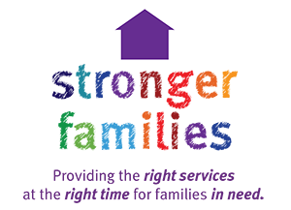
Structuring the Array of Services
and Supports

Slide 38
Services/Supports Array Focused on a Total Population
Universal Targeted
Core Services Prevention Early Intervention Intensive Services
Family Support Services
Youth Development Program/Activities
Coordinated Intake Assessment & Service Planning
Service Coordination
Intensive Care Management
Mobile Response
Treatment Services
School Supports
School-Wide Climate Change Initiatives
Pires, S. & Isaacs, M. (1996, May) Service delivery and systems reform. [Training module for Annie E. Casey Foundation Urban Mental Health Initiative Training of Trainer Is Conference]. Washington, DC: Human Service Collaborative.

Slide 39
CMS/SAMHSA May 2013 Joint Information Bulletin
Intensive Care Coordination: Wraparound Approach
Parent and Youth Support Services
Intensive In-Home Services
Respite
Mobile Crisis Response and Stabilization
Flex Funds
Trauma Informed Systems and Evidence-Based Treatments Addressing Trauma
Joint CMCS and SAMHSA Informational Bulletin: Coverage of Behavioral Health Services
for Children, Youth, and Young Adults with Significant Mental Health Conditions

Slide 40
Home and Community-Based Services, Peer and Recovery Supports, Evidence-Informed Practices, Trauma-Informed Approaches
Emphasized in..
  Medicaid: CMCS/SAMHSA May 7 2013 and January 26 2015 Joint Information Bulletins
  IV-E (Child Welfare) Waivers and Family First Prevention Act
  Juvenile Detention Alternatives
  Federal Discretionary Grant Programs
  EPSDT (Medicaid) and Child Welfare Lawsuits

Slide 41
Service Array Considerations
Trauma-Informed Systems and
Evidence-Based Trauma Treatments
Increased awareness of the impact of trauma
Children and youth with most challenging mental health needs often have experienced significant trauma
Telehealth and Mobile Technology
Using communications technology to provide access to
health/behavioral health assessment, diagnosis, intervention,
consultation, supervision, education, care coordination and
peer support across distance
Managing and Adapting Practice
Systemic approach to raising the quality of “usual care”

Slide 42
Growing Conclusion by State, Tribal and Local Purchasers
Redirect spending from residential interventions with high costs and/or poor outcomes
to home and community-based services and supports in a system of care
Pires, S. (2006). Primer Hands On . Washington, D.C.: Human Service Collaborative.

Slide 43
Implications for Residential Interventions
Movement away from “placement” orientation and long lengths of stay
Residential as part of an integrated continuum, connected to community
Shared decision making with families/youth and other providers and agencies
Individualized treatment approaches through a child and family team process
Trauma-informed care
For more information, go to Building Bridges Initiative:
www.buildingbridges4youth.org
Data Trends #127, February 2006,University of South Florida.

Slide 44
Evidence Based and Informed Approaches in New Jersey
Nurtured Heart Approach
The Nurtured Heart Approach Large Scale Adoption
Wraparound for youth with Moderate and Complex Needs with Behavioral Health, Substance Use, Intellectual/Developmental Disabilities
Functional Family Therapy for youth engaged with Juvenile Justice and Child Welfare Systems
Multisystemic Therapy specific for youth engage with Family Court
Wraparound
Functional Family Therapy (CW)
Multisystemic Therapy

Slide 45

Residential Interventions in a System of Care
Home Like Environment
Trauma Informed
Goal is for the child to feel better
No breaks for the team during the residential intervention
There are diminishing returns on long lengths of stay

Slide 46

Structuring Care Coordination

Slide 47
Unmet Need
Family-centered care can be mitigating
Unmet need for care coordination is high for children and youth with mental health conditions
American Academy of Pediatrics (Brown, N. et. al. 2013)

Slide 48
Care Coordination Continuum –
What Belongs Where?
All Children
Children with an
Identified Behavioral Health Need
Children with Complex Behavioral Health Needs
Screening, Information and Referral on an as Needed Basis/ During Well Child Visits
Service Coordination and System Navigation To Support Effective Response to Identified Need
Intensive Customized Care Coordination To Provide Extended Support To Multi-Modal Needs

Slide 49
Unmet Need for Children with Significant Behavioral Health Challenges
Not Met by Usual Approaches
Neither traditional case management, MCO care coordination, nor health home approaches for adults are sufficient for children and youth with significant
behavioral health needs
  Need:
  Lower case ratios (MO health home care coordination ratio is 1:250*; Wraparound is 1:10)
  Higher payment rates (MO health home per member per month rate is $78*; CHCS national scan of Wraparound care coordination rate ranges from $780 pmpm to $1300 pmpm)
  Approach based on evidence of effectiveness, i.e. fidelity Wraparound
  Intensity of approach that is largely face-to-face, not telephonic
  Intensity of involvement with family, schools, other systems like child welfare
L. Alexander, B. Druss, and J. Parks. “A (Health) Home Run: Operationalizing Behavioral Health Homes.” Webinar,
Center for Integrated Health Solutions, U.S. Substance Abuse and Mental Health Services Administration, January 2013.

Slide 50
Expert Convening: Care Coordination Continuum
Integration Continuum (nested within common value/principles)
Across the continuum: Family and Youth Peer Support/Navigators and Measurement-Based (Metrics Across Continuum)
All children: Pediatric primary care services, including promotion of social-emotional development, developmental and behavioral health screening, and family psychosocial screening with a broader focus on social determinants of health.
Could occur in primary care, behavioral health, school-based or other community setting
Children with Identified Need
Child Behavioral Health Consultation Programs, which include behavioral health consultation to primary care practitioners and coordination by behavioral health.
Could occur in primary care, behavioral health, school-based or other community setting
Low/Moderate Need
Team-based care with appropriate infrastructure.
Could occur in primary care, behavioral health, school-based or other community setting
Significant Need/High Risk
Intensive Care Coordination using High Fidelity Wraparound.
Could occur in primary care, behavioral health, school-based or other community setting
Pires, S., Fields, S, et.al., 2018 (in process) Care Integration Opportunities in Primary Care for Children, Youth and Young
Adults with Behavioral Health Challenges: Expert Convening. National Technical Assistance Network for Children’s
Behavioral Health

Slide 51
Why Are Outcomes So Poor and Costs So High?
Youth with serious EBD typically have multiple and overlapping areas that need attention
Child and family needs are complex
Youth with serious EBD typically have multiple and overlapping areas that need attention
Families often have unmet basic needs
Families are often not fully engaged in services
Families often feel that the system is not working for them
Limited engagement leads to treatment dropouts and missed opportunities
Systems are in “silos”
Systems don’t work together well for individual families unless there is a way to bring them together
- Youth get passed from one system to another as problems get worse
- Families relinquish custody to get help
- Children are placed out of home
Traditional services don’t attend to health, mental health, substance abuse, and basic needs holistically
Or even know how to prioritize what to work on
Bruns, E. National Wraparound Initiative

Slide 52
Important Points About the Wraparound Process
Wraparound is a defined, team-based service planning and coordination process
The Wraparound process ensures that there is one coordinated plan of care and one care coordinator
Wraparound is not a service per se, it is a structured approach to service planning and care coordination
The ultimate goal is both to improve outcomes and per capita costs of care
Bruns, E. National Wraparound Initiative

Slide 53
In wraparound, a dedicated care coordinator coordinates the work of system partners and other natural helpers so there is one coordinated plan
Care Coordinator
(+ Parent/Youth Partner)
Juvenile Justice
Education
Child welfare
Health care
Behavioral Health
FAMILY
“Natural Supports”
Extended family
Neighbors
Friends
YOUTH
“Community Supports”
Neighborhood
Civic
Faith-based
ONE PLAN
Adapted from Laura Burger Lucas, ohana coaching, 2009

Slide 54
What’s Different in Wraparound?
High quality Teamwork
  Collaborative activity
  Brainstorming options
  Goal setting and progress monitoring
The plan and the team process is driven by and “owned” by the family and youth
Taking a strengths based approach
The plan focuses on the priority needs as identified by the youth and family
A whole youth and family focus
A focus on developing optimism and self-efficacy
A focus on developing enduring social supports
Bruns, E. National Wraparound Initiative

Slide 55
Wraparound is Associated with Improved Outcomes
Better functioning and mental health outcomes
Reduced recidivism and better juvenile justice outcomes
Increased rate of case closure for child welfare involved youths
Reduction in costs associated with residential placements
See Bruns & Suter, 2010; Coldiron, Bruns, & Quick, 2017

Slide 56
Lower Costs and Fewer Residential Stays
Wraparound Milwaukee
Reduced psychiatric hospitalization from 5000 to less than 200 days annually
Reduced average daily residential treatment facility population from 375 to 50 (Kamradt & Jefferson, 2008)
Controlled study of Mental Health Services Program for Youth in Massachusetts (Grimes, 2011)
Reduced psychiatric hospitalization from 5000 to less than 200 days annually
Reduced average daily residential treatment facility population from 375 to 50 (Kamradt & Jefferson, 2008)
CMS Psychiatric Residential Treatment Facility Waiver Demonstration (Urdapilleta et al., 2011)
Reduced average daily residential treatment facility population from 375 to 50 (Kamradt & Jefferson, 2008)
New Jersey
Maine
Los Angeles County Dept. of Social Services
Saved over $30 million in inpatient psychiatric expenditures over 3 years (Hancock, 2012)
Reduced net Medicaid spending by 30%, even as use of home and community services increased
Found 12 month placement costs were $10,800 for wraparound-discharged youths compared to $27,400 for matched group of residential treatment center youths
43% reduction in inpatient and 29% in residential treatment expenses (Yoe, Bruns, & Ryan, 2011)

Slide 57
However, Outcomes Depend on Implementation
Studies indicate that Wraparound teams often fail to:
  Engage key individuals in the Wraparound team
  Connect youth in community activities and things they do well; activities to help develop friendships
  Use family/community strengths
  Incorporate natural supports, such as extended family members and community members
  Use evidence-based clinical strategies to meet needs
  Continuously assess progress, satisfaction, and outcomes
Bruns, E. NWI

Slide 58
“Full Fidelity” is Critical
Research shows
  Provider staff whose families experience better outcomes score higher on fidelity tools (Bruns, Rast et al., 2006)
  Wraparound initiatives with positive fidelity assessments demonstrate more positive outcomes (Bruns, Leverentz-Brady, & Suter, 2008)
Much of wraparound implementation is in name only
  Don’t invest in workforce development such as training and coaching to accreditation
  Don’t follow the research-based practice model
  Don’t monitor fidelity and outcomes and use the data for CQI
  Don’t have the necessary support conditions to succeed (e.g., fiscal supports, comprehensive service array)
Bruns, E. NWI

Slide 59
Outcomes Depend on Implementation
Bruns, E. NWI

Slide 60
National Standards
Standards are grounded in a strong foundation of implementation science research and based on research evidence.
Across seven implementation related areas there are 43 indicators with definitions that can be used as a self assessment as well as monitoring of quality indicators throughout the implementation process.
Outcomes are highly dependent on program and system factors
  Eligibility (do we have the right population?)
  Funding (do we have the right rate?)
  Staffing ratios (1:10)
  Workforce development (hiring, training and skill development)
  System policies that create climates and cultures that support practice implementation efforts and providers

Slide 61
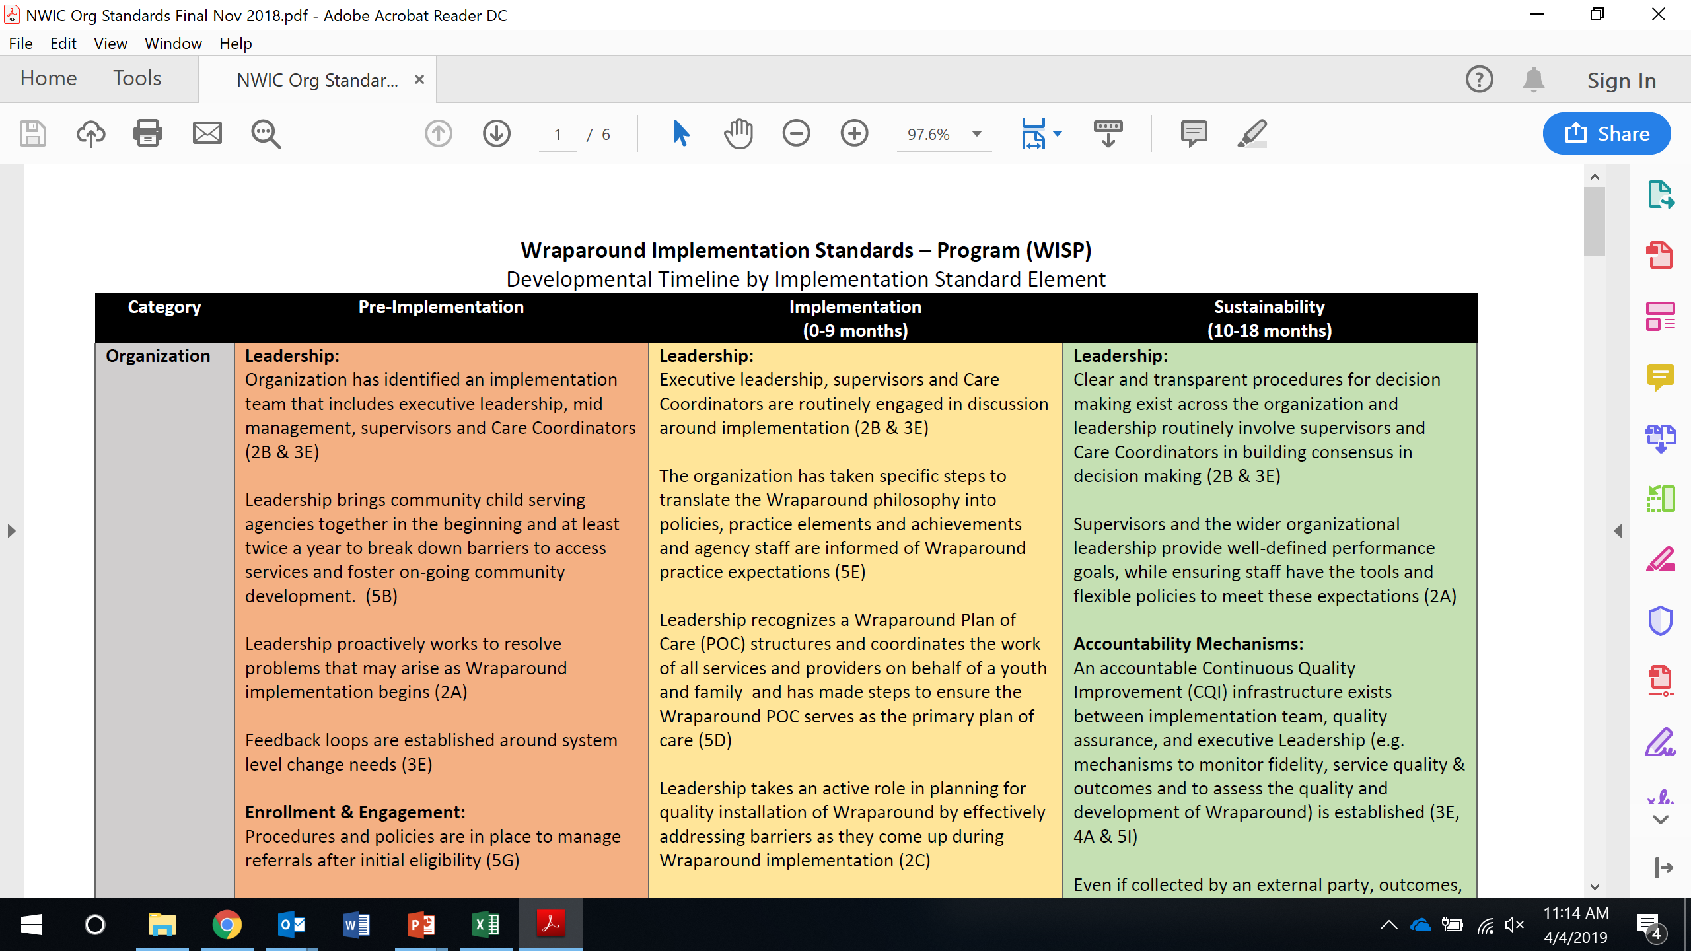
Wraparound Implementation Standards – Program (WISP)

Slide 62
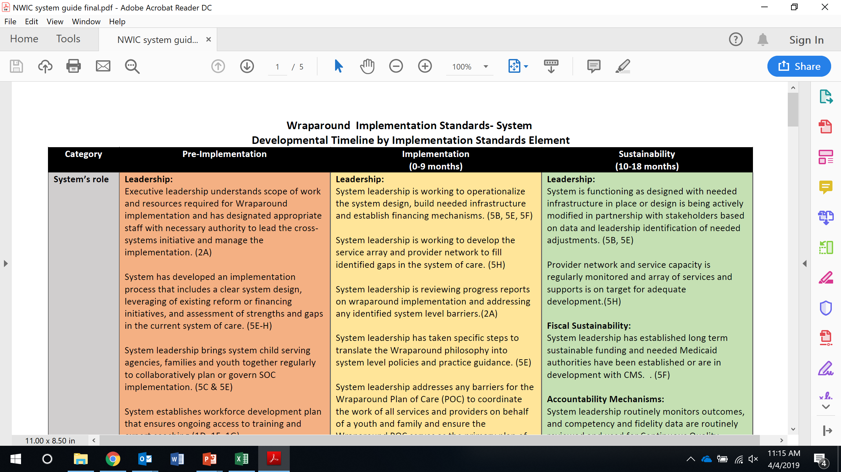
Wraparound Implementation Standards – System (WISS)

Slide 63
Family & Youth Partners
Build relationship based on mutuality and trust
Promote self-advocacy: voice & choice
Identify and build natural supports
Bridge of communication with providers
Service navigation and securing community resources
Connect to support groups and education-skills based trainings
Assist with completing care plan goals and action steps
Celebrate accomplishments
Conlan, L. 2018. Parent Support Network of Rhode Island

Slide 64
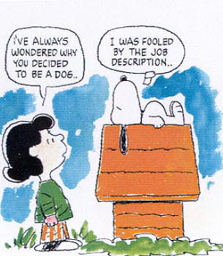

Workforce and Provider Network Development

Slide 65
Characteristics of
Effective Provider Networks
Responsive to the population(s) of focus
Encompass both clinical treatment service providers and natural supports, such as mentors and respite workers
Include both traditional and non traditional, indigenous providers
Include culturally and linguistically diverse providers
Operate from multicultural, intersectionality and cultural humility perspectives
Include families and youth as providers of services and supports
Are flexible, structured in a way that allows for additions/deletions
Are accountable, structured to serve the system of care
Committed to evidence-based and promising practices
Are trauma-informed
Encompass choice for families and youth
Pires, S. (2010). Building systems of care: A primer, 2nd Edition. Washington, D.C.: Human Service Collaborative for Georgetown University National Technical Assistance Center for Children’s Mental Health

Slide 66
STRATEGIES FOR ATTRACTING AND RETAINING A DIVERSE WORKFORCE
Reflect cultural competence goals in hiring policies and practices | Diversify job posting and advertising | Network with community partners | Maintain a diverse, welcoming work environment | Offer incentives and opportunities for advancement
Designate funds for diverse hiring Adapt job descriptions to reflect desired linguistic and cultural skills Assign a staff member to oversee diverse recruiting Develop policies that encourage leadership building from within Develop and use appropriate grievance and complaint processes | Advertise job openings in ethnic media Post jobs in different languages Advertise jobs with community partners (e.g., professional minority associations, community organizations, immigrant assistance services) Develop a staff referral program | Find candidates through mentoring programs and community-based and university internships Recruit at minority health fairs and job fairs Sponsor and support cultural events and celebrations Seek referrals from community partners | Encourage the exchange of cultural information in informal and formal settings (staff meetings, trainings, team-building events, potluck lunches) Offer staff mediation and other conflict-resolution mechanisms | Offer continuing education credits for cultural competence training Link cultural competence with certification programs Offer scholarships and continuing education opportunities Promote from within
Making CLAS Happen (2013) Commonwealth of Massachusetts, Dept. of Public Health

Slide 67

The Role of Natural Helpers & Informal Supports
Emotional support; moral & spiritual guidance
System navigation
Concrete help & advocacy
Decrease social isolation
Community navigation
Resource acquisition & education
Greater understanding of
intervention or support strategies
Natural Helpers /Informal Supports are…
Family and friends
Neighbors
Volunteers
Individuals in the community, e.g. mail carrier, minister, storekeeper, etc.
People with similar experiences
Faith-based organizations
Lazear, K. (2010). Primer Hands On

Slide 68
A Developmental SOC Training Approach (1)
TRADITIONAL MODIFIED INTEGRATED UNIFIED
SYSTEMS
LEVEL
PROGRAM
LEVEL
State systems
develop training
along specialty
guild lines –
Promotion of
stronger specialty focus
Community
agencies and universities
operate in isolation
Disciplines train
in isolation from
one another
Instruction is didactic, “expert”
No support for
cross-training
State systems
independently
adopt similar
philosophy,
promoting
Collaboration
Community
agencies and
universities
begin joint research and evaluation
Pre-service training remains separate from the field
State systems
begin sharing
training calendars
Promotion of
cross-training;
joint funding
Community agencies and
universities begin to integrate field staff/families into
pre-service training
Student field placements cross agency boundaries
Cross-agency training gains support
State systems pool training resources, merge training events,
partner with family and youth orgs to shape training
Community agencies and universities
Collaborate with larger
community, e.g. families as co-instructors; curricula reflect practice goals
Training geared
to system goals
Meyers, J., Kaufman, M. & Goldman, S. (1991). Training strategies for serving children with serious emotional disturbances and their families in a system of care. Promising Practices in children’s mental health. 5. Washington, D.C.: American Institutes for Research.

Slide 69
A Developmental SOC Training Approach (2)
TRADITIONAL MODIFIED INTEGRATED UNIFIED
PRACTICE
LEVEL
Participation
in professional
conferences on
individual basis
within agency
boundaries
Services are
provided within
agency boundaries
Staff receive
training that
promotes
collaboration,
but receive it
within agency
boundaries
Specialty focus
predominant
Services remain
within agency
boundaries
Service
teaming is
promoted
through cross-
agency training
Service teams
with full family
inclusion are the
norm
Redefined specialty
practice roles develop
to support
professional identity
while promoting
collaboration
Meyers, J., Kaufman, M. & Goldman, S. (1991). Training strategies for serving children with serious emotional disturbances and their families in a system of care. Promising Practices in children’s mental health. 5. Washington, D.C.: American Institutes for Research.

Slide 70
NJ Center for Excellence and Workforce Development
Roles for Each Partner
Center for Excellence
NJ Children’s System of Care
Contracted Systems Administrator PerformCare
Rutgers Training Partners
Boggs Center/Center of Excellence for IDD
Autism NJ
NJ CSOC sets the vision, policy, budget and manages the provider pool.
The CSA, PerformCare, is the single point of access, provides utilization management, has the electronic record, and connects to Medicaid.
Rutgers Training Partners train the workforce and communities and has responsibility for the certification process for CANS, Care Management, Family Support, MRSS and Behavioral Assistance, provides coaching and technical assistance.
Boggs Center responsible for training and consultation specific to youth with IDD.
Autism NJ responsible for the training and consultation specific to Autism.

Slide 71
Strategic Communications Planning is needed for:
Internal Organizational Change
External System Partner and Stakeholder Engagement
Outreach to population of focus
Based on strategic plan
For each goal
  Target audiences
  Tailored messages
  Message delivery media
  Frequency/sequencing

Slide 72
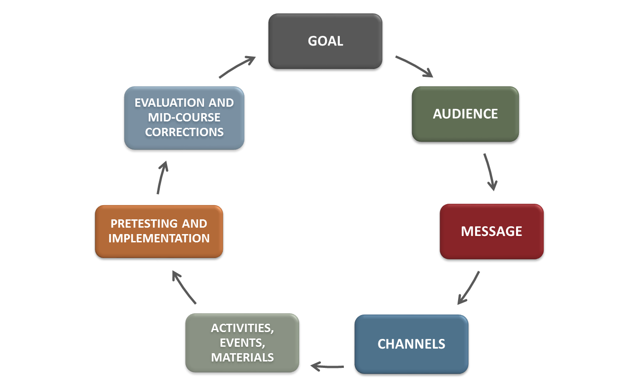
How do you do it?
72
Notes:
Explain that there is a process for social marketing that needs to be completed in full in order to be strategic about social marketing efforts. **Note that for this presentation, we will focus in on audience identification, segmentation, and message development, and discuss how data and storytelling are utilized in these steps.
What is my social marketing goal?
Your social marketing plan goals should state desired outcomes for your communications efforts.
Who is the primary audience?
Individuals or groups within the stakeholder communities that you need to engage to reach program goals.
What are the messages to which your audience will respond?
Messages are closely tied to your goals and deliver important information about the issue compelling the intended audience to think, feel, or act.
What channels will reach your audiences?
Communications channels carry the messages to the target audiences.
What activities, events, and materials will get their attention and get them involved?
Activities, events, and/or materials—to be used in your selected channels—that will most effectively carry your message to the intended audiences.
Pre-testing and Implementation
Messages should be pre-tested with the intended audiences to assure understanding and other intended responses.
Evaluation and Mid-course Corrections
Evaluating your social marketing efforts allows you to correct your plans mid-course, or to inform the next iteration of the social marketing planning process (it is continuous!)

Slide 73


Financing

Slide 74

Strategic Financing Agenda
Move from a mentality of “funding programs and providing grants” to “collaborative financing to support a strategic agenda”
How do you want to use your dollars to promote a unified agenda and achieve outcomes for shared populations of focus?
Pires, S. (2010). Building systems of care: A primer, 2nd Edition. Washington, D.C.: Human Service Collaborative for Georgetown University National Technical Assistance Center for Children’s Mental Health

Slide 75

First Questions for Strategic Financing
Strategic financing begins with cross-system and community stakeholders answering two questions:
Financing for whom???
Financing for what???
Pires, S. (2010). Building systems of care: A primer, 2nd Edition. Washington, D.C.: Human Service Collaborative for Georgetown University National Technical Assistance Center for Children’s Mental Health

Slide 76
Financing for Whom?
Identify and understand population(s) of focus
  Demographics ,e.g., culture/race/ethnicity, economics, etc.
  Size
  Strengths, issues and needs
Analyze Data (quantitative and qualitative)
The more you understand about your population(s) of focus, the more strategic you can be about financing.

Slide 77
Financing for What?
What are the outcomes you want to achieve with respect to your identified population(s) of focus?
This is governed by your values – is there consensus?

Slide 78
Financing for What?
How will services/supports be organized? What is the system design?
Customization within Medicaid delivery system?
What is the administrative/system infrastructure needed to support the delivery system?
Training and capacity development?
Changes in what child welfare, juvenile justice, schools, behavioral health systems provide?
Specialized cross-system capacity? (e.g., Care Management Entities; Family-Run Organizations; Youth-Run Organizations; screening and assessment)
IT systems?
Cross-agency governance?
Social marketing/strategic communications capacity?
Quality oversight and outcomes tracking?
Pires, S. (2010). Building systems of care: A primer, 2nd Edition. Washington, D.C.: Human Service Collaborative for Georgetown University National Technical Assistance Center for Children’s Mental Health

Slide 79

If You Have Answered the Questions:
Financing for Whom? Financing for What?
Identified your population(s) of focus
Agreed on underlying values and intended outcomes
Identified services/supports and practice model to achieve outcomes
Identified how services/supports will be organized –
system design
Identified the administrative/system infrastructure needed to support the delivery system
Estimated costs
Then You Are Ready To Talk About Financing Strategies!

Slide 80

Financing Strategies to Support Improved Outcomes
for Children, Youth and Families
  FIRST PRINCIPLE: Strategic Agenda for Populations of Focus Drives Financing
REDEPLOYMENT Using the money we already have The cost of doing nothing Shifting funds from high cost/poor outcome services to effective practices Moving across fiscal years | REFINANCING Generating new money by increasing federal claims The commitment to reinvest funds for families and children Foster Care and Adoption Assistance (Title IV-E) Medicaid (Title XIX)
RAISING OTHER REVENUE TO SUPPORT FAMILIES AND CHILDREN Donations Special taxes and taxing districts for children Fees and third party collections including child support Trust funds | FINANCING STRUCTURES THAT SUPPORT GOALS Seamless services: Financial claiming invisible to families Funding pools: Breaking the lock of agency ownership of funds Flexible Dollars: Removing the barriers to meeting the unique needs of families Incentives: Rewarding good practice
Adapted from Friedman, M. (1995). Financing strategies to support improved outcomes for children.
Washington, DC: Center for the Study of Social Policy.

Slide 81
New Jersey Federal Funding Mechanisms
Medicaid Rehab Option: In-home services, EBPs, Mobile Response and Stabilization, Therapeutic Foster Care
Targeted Case Management: Care Management Entities
Medicaid Administrative Cost Allocation Plan: Family Support Organizations, ASO Contract, State Services
Medicaid Health Home State Plan Amendment: Wellness, Primary Care Integration
Medicaid 1115 Research and Demonstration Waiver: SUD services, transportation

Slide 82

Summary of Financing Strategies
Maximize Medicaid
Blend, braid or intentionally coordinate funding streams across systems
Redirect spending from high cost and/or poor outcome services to effective practices
Manage dollars through managed care arrangements that are tied to values and goals
Risk adjust payment for complex populations of children (e.g., risk-adjusted capitation rates to MCOs; case rates to providers)
Finance:
  Locus of accountability, e.g., care management entities for most complex, cross-system
  Family and youth partnerships at policy, management and service levels
  Training, capacity building, quality and outcomes monitoring
  Broad, flexible array of services and supports

Slide 83
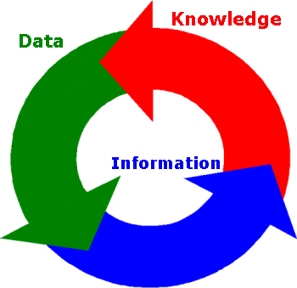
Data
“If we have data, let’s look at data. If all we have are opinions, let’s go with mine.”
Jim Barksdale, former CEO, Netscape

Slide 84
The Importance of Data
Understanding the data
Understanding opportunities to improve the quality and cost of care
Pires, S. (2010). Building systems of care: A primer, 2nd Edition. Washington, D.C.: Human Service Collaborative for Georgetown University National Technical Assistance Center for Children’s Mental Health

Slide 85
Guiding Implementation
Referrals and enrollment by geographic area and by agency tracked over time
Wraparound provider certification and quality review
Use of peer support services
Network development of key services- number and distribution of providers
Number and length of stay in inpatient settings
Use of home and community based services

Slide 86

Guiding Implementation
Qualitative Data Can Tell You
How families and youth experience the system
Strengths and weaknesses in the provider network
How providers experience the system
How key system partners experience the system
(e.g. child welfare workers, juvenile probation officers, school personnel, court personnel)
Recommendations for improvement

Slide 87
Accountability Functions
Utilization Management
Quality Improvement
Cost and Outcome Monitoring
Pires, S.A. Primer Hands On – Human Service Collaborative, Washington, D.C.

Slide 88
Demonstrating Value
Build support for sustainability and expansion
Educate leadership and funders
To build internal staff support
Build stakeholder support
Support of agency leadership
Show return on investment

Slide 89
New Jersey Tracking Evidence of Progress
Increase in Access to Care
Decrease in over reliance on residential interventions
Decrease in over reliance on detention with 9 centers closing
Decrease by 70% the population of youth who are on Probation
The only state hospital has closed
Have brought all children with behavioral health challenges home to NJ
Decrease in use of restraint, seclusion and coercion in residential interventions.

Slide 90
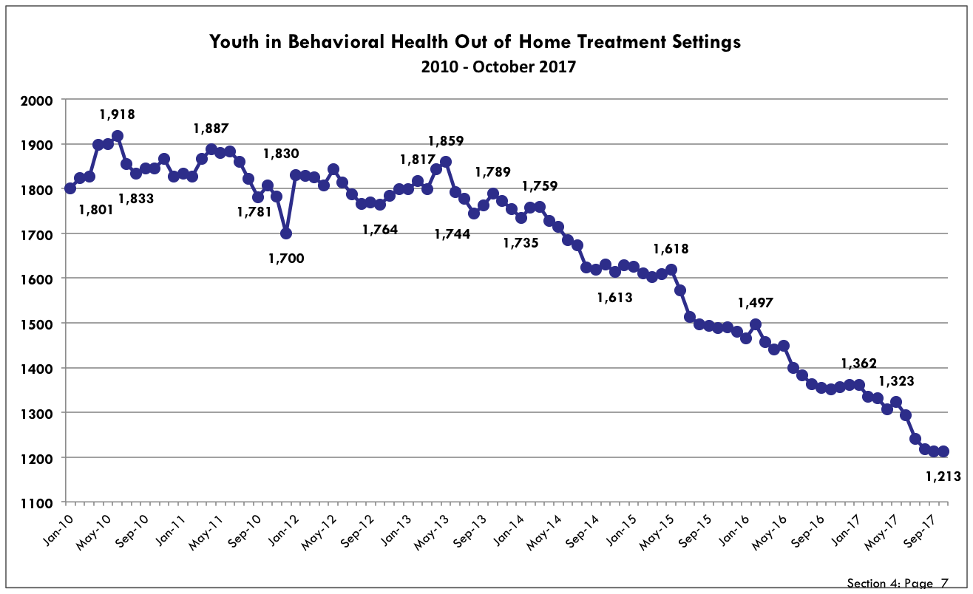
New Jersey Tracking Progress

Slide 91
Lessons from the Field:
Set the vision and don’t move away from the vision
Communicate, communicate, communicate
Youth and family voices are the drivers to innovation
The building blocks to systems of care work in coordination and not as well in isolation
Community engagement and participation is essential
It is not a program, but systems transformation
Anything and all things are possible, just look at NJ

Slide 92

Final Thoughts?

Slide 93
References:
Blau, Caldwell, Lieberman (2014). Residential Interventions for Children, Adolescents, and Families. Routledge, NY and London.
Making the Case for a Comprehensive Children’s Crisis Continuum of Care; NASMHPD 2018; https://www.nasmhpd.org/sites/default/files/TACPaper8_ChildrensCrisisContinuumofCare_508C.pdf
Pires, Sheila; Building Systems of Care: A Primer; 2002; https://gucchd.georgetown.edu/products/PRIMER_CompleteBook.pdf
Pires, Sheila; Customizing Health Homes for Children with Serious Behavioral Health Challenges; 2013; https://nwi.pdx.edu/pdf/CustomizingHealthHomes.pdf
Intensive Care Coordination Using High Quality Wraparound: Rates and Billing Structure; TA Network; 2015; https://theinstitute.umaryland.edu/media/ssw/institute/national-center-documents/Intensive-Care-Coordination-Using-HQ-Wraparound-Rates-and-Billing-Structure.pdf
Stroul, B.A., & Blau, G.M. (Eds.). (2008). The system of care handbook: Transforming mental health services for children, youth and families, Baltimore, MD: Paul H. Brookes Publishing Co.
Glasser, H. (2018). The nurtured heart approach. Retrieved from https://childrenssuccessfoundation.com
Huckshorn, K. (2008). Six Core Strategies to Reduce Seclusion and Restraint Use. Retrieved from https://www.nasmhpd.org/content/six-core-strategies-reduce-seclusion-and-restraint-use
Georgia System of Care State Plan 2017; Georgia Health Policy Center; https://dbhdd.georgia.gov/sites/dbhdd.georgia.gov/files/related_files/site_page/SOC%20State%20Plan%202017_FINAL%20%28002%29.pdf

Slide 94
References Continued
Arauz, Eric C., An American’s Resurrection: My Pilgrimage from Child Abuse and Mental Illness to Salvation. Treehouse Publishing, St. Louis, MO, 2012.
Armstrong M.I., Blase, K., Caldwell,B. HoltW., King-Miller, T., Kuppinger, A., Obrochta, C., Policella, D.N., &Wallace, F. (2006). Final report: Independent assessment of the New Jersey’s children’s behavioral health care system. Tampa, FL The University of South Florida. Louis de la Parte Florida Mental Health Institute. (FMHI Publication #239)
Berrick, Ken and Sprinson, John S. Unconditional Care; Relationship-Based, Behavioral Intervention with Vulnerable Children and Families, Seneca Center. Oxford University Press, NY 2010
Burns, Barbara and Kimberly Hoagwood. Community Treatment for Youth: Evidence-Based Interventions for Severe Emotional Disturbance. Oxford Press, NY, 2007.
Dennis, Karl and Lourie, Ira. Everything is Normal Until Proven Otherwise: A Book About Wraparound Services. CWLA Press, Washington, D.C., 2006.
Lyons, John S. Redressing the Emperor: Improving Our Children’s Public Mental Health System. Praeger Publishers. Westport, Connecticut and London. 2004
Perry, Bruce D. M.D.,Ph.D. and Szalavitz. The Boy Who Was Raised as a Dog and other stories from a Child Psychiatrist’s Notebook. Basic Books. New York, NY, 2006.
Saxe, G., Ellis, H., Brown, A. Trauma Systems Therapy for Children and Teens. The Guilford Press, NY 2016.
Siegel, Daniel J. M.D. Mindsight: The New Science of Personal Transformation. Bantam Books, NY, NY 2010.
Solomon, Andrew. Far From the Tree: Parents, Children, and the Search for Identity. Scribner. NY, NY 2012.
Stroul, B., Dodge,J., Goldman, S., Rider, F., & Friedman, R. (2015). Toolkit for Expanding the System of Care Approach. Washington, DC: Georgetown University Center for Child and Human Development, National Technical Assistance Center for Children’s Mental Health.

Slide 95
References Continued:
https://www.casey.org/nj-mobile-response-stabilization-services/
https://www.state.nj.us/dcf/documents/home/childdata/behavioral/DCBHS10yrReview.pdf
https://www.nj.gov/dcf/about/divisions/dcsc/CSOC_15.Year.Conference.Presentation.pdf
https://www.medicaid.gov/federal-policy-guidance/downloads/cib-05-07-2013.pdf
https://www.nj.gov/dcf/about/divisions/dcsc/Childrens.Initiative.Concept.Paper.pdf

Slide 96
Thank you
Elizabeth Manley
elizabeth.manley@ssw.umaryland.edu

Slide 97
Liz Manley
The TA Network for Children’s Behavioral Health
elizabeth.manley@sww.umaryland.edu

